Slide 1
Generative
AI
Agentic AI
MCP
[Model context Protocol]
Empowering creativity and intelligence by generating human-like content, automating tasks, and enhancing decision-making through advanced models.
Trained By:
Enabling autonomous reasoning by combining tools, memory, and goals to perform complex tasks with minimal human intervention
Trained By:
Structuring agent behavior by defining tools, memory, and context to enable dynamic, goal-driven AI interactions at runtime.
Trained By:

Slide 2
Generative AI
Generative AI refers to a category of artificial intelligence that can create new content such as text, images, audio, video, code, and more. Unlike traditional AI that focuses on tasks like classification or prediction, generative AI produces data that mimics or extends the data it has been trained on.
Key Concepts:
Transformer Architecture
Pretraining and Finetuning of LLM
Prompt Engineering – Optimizing AI responses for specific tasks
Generative
AI
Agentic AI
MCP
[Model context Protocol]

Slide 3
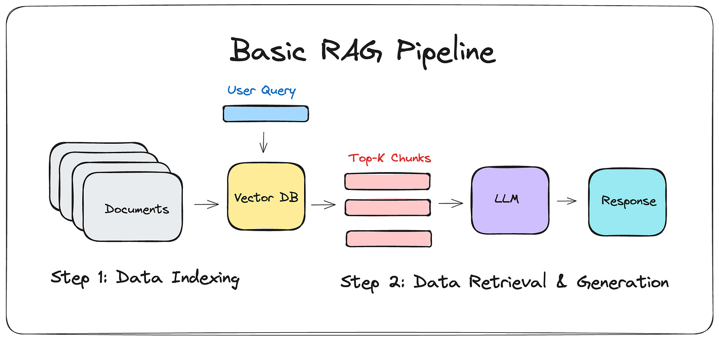
RAG
Retrieval-Augmented Generation (RAG) is an AI framework that combines document retrieval with text generation. It first fetches relevant information from an external knowledge base and then uses a language model to generate accurate, context-rich responses. This makes RAG powerful for tasks like question answering and summarization where up-to-date or detailed information is needed.

Slide 4
Agentic AI
Generative
AI
Agentic AI
MCP
[Model context Protocol]
Agentic AI refers to AI systems that act autonomously, making decisions, setting goals, and executing tasks without human intervention. Uses techniques like Reinforcement Learning (RL) and multi-agent collaboration to optimize task execution.
Key Concepts:
Autonomous AI Agents – AI systems that reason, plan, and execute actions
Agent Framework – Langchain and Autogen
Reinforcement Learning – AI that improves through trial and error
Ethical AI & Safety Considerations – Ensuring AI makes responsible decisions

Slide 5
LangChain
LangChain is a powerful framework that helps developers build applications using large language models (LLMs) like GPT-4, Claude, or LLaMA — especially those involving retrieval, reasoning, and memory.

Slide 6
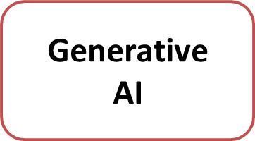
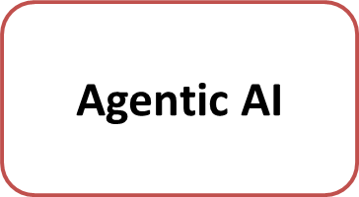
MCP
MCP
[Model Context Protocol]
Challenges Before MCP | After MCP – What Has Changed
Data scattered across siloed systems, causing inefficiency | Centralized platform integrates all data and processes.
Lack of real-time visibility and delayed decisions. | Real-time monitoring enables faster, accurate decisions.
Manual workflows leading to errors anaad delays. | Automated workflows improve accuracy and efficiency.
 | Improved collaboration with unified access and communication.

Slide 7
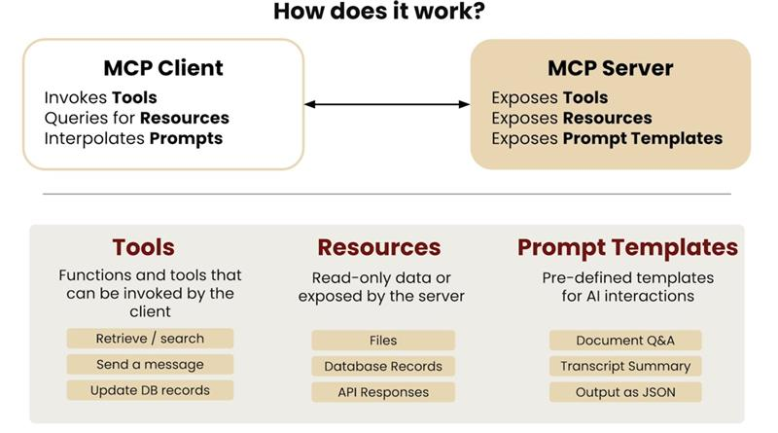
MCP Architecture

Slide 8
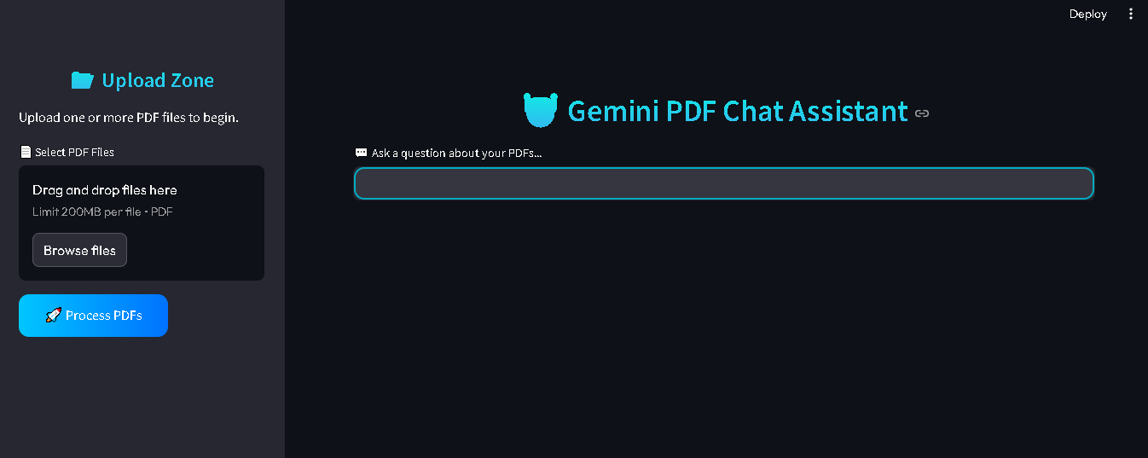
RAG BASED POC
User uploads documents.
App converts and stores them as vector embedding.
User asks a question model t
Relevant content is retrieved.
LLM answers using relevant content and user query.espond to user

Slide 9
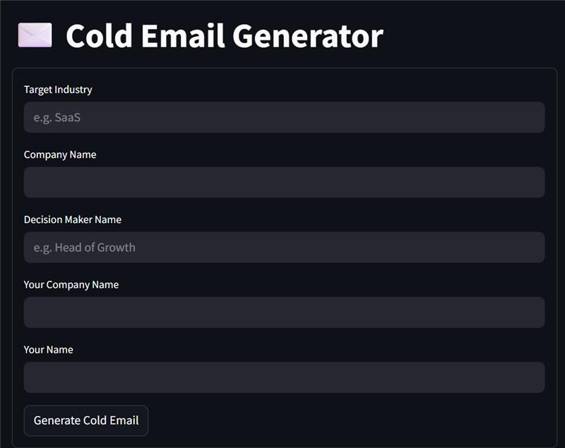
AGENTIC AI POC
User Input Collection via Form.
Automated Market Research using SERP API.
Contextual Prompt Creation for Gemini AI.
Cold Email Generation and Display.

